Slide 1

Fundamental Of Structured Programming
Lecture 2
By
Dr. Naglaa Fathy
Lecturer, Computer Science Department,
Faculty of computers and artificial intelligence, benha university

Slide 2
Four Flowchart Structures
Sequence
Decision
Repetition
Case

Slide 3
Sequence Structure
A series of actions are performed in sequence

Slide 4
Exercise _1
Design a Flowchart to convert a temperature in degrees Fahrenheit to degrees Celsius.
Hint: Celsius = 5/9 * (Fahrenheit – 32).
Start
Read Fahrenheit
Celsius = 5/9 * (Fahrenheit – 32)
Output
Celsius
End

Slide 5
Exercise_2
Design a Flowchart that accepts two numbers and computes their sum, difference, product, and quotient.
Start
Read Num1
Read Num2
Sum = Num1 +Num2
Difference = Num1 - Num2
Product = Num1 * Num2
Quotient = Num1/Num2
Print Sum
Print Difference
Print Product
Print Quotient
END

Slide 6
Exercise _ 3
You work in a store that sells imported fabric. Most of the fabric you sell is measured in square yards, but your customers want to know the equivalent amount in square meters. Design an Flowchart to perform this conversion.
Hint:
1 square meter = 1.198 yards
Start
Read value in Yard (Y)
Square meter Value (S) = Y/1.198
Output S
END

Slide 7
Exercise _ 4
Design a Flowchart that computes the employee’s gross salary and Net salary given the hours work and the hourly rate. Assume that 15% of the salary is deducted as taxes.
Start
Read Hours Work (H)
Read Hourly Rate (R)
Gross Salary = H * R
Tax = (15/100) * Gross Salary
Net Salary = Gross Salary - Tax
Print Net Salary
END

Slide 8


Exercise _ 5
Design a Flowchart that computes the distance between two points (X1, Y1) and (X2,Y2).
Hint: Distance =
Start
Read X1
Read X2
Read Y1
Read Y2
Z1 = (x1 – x2)
Z2 = (y1 – y)
Distance =
Output Distance
END

Slide 9
Decision Structure
One of two possible actions is taken, depending on a condition

Slide 10
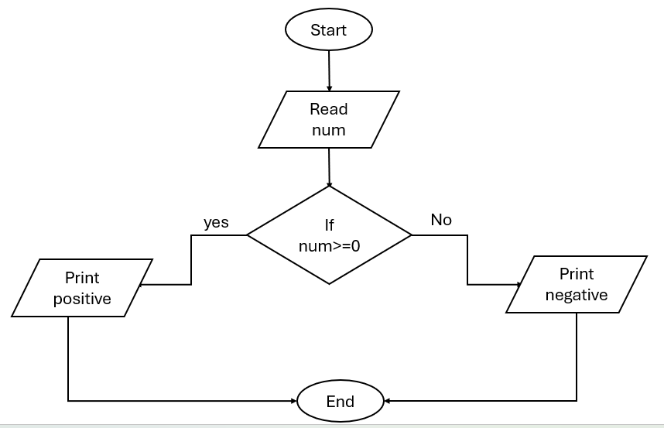
Exercise _ 6
Create a Flowchart that represents the process of checking if a number is positive or negative

Slide 11
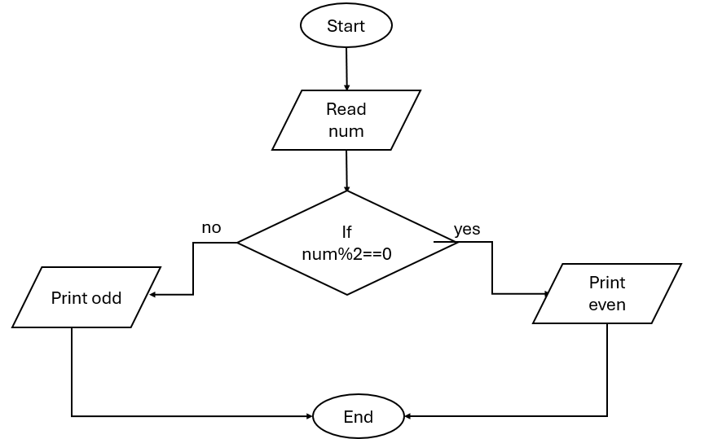
Exercise _ 7
Create a Flowchart that represents the process of checking if a number is even or odd

Slide 12
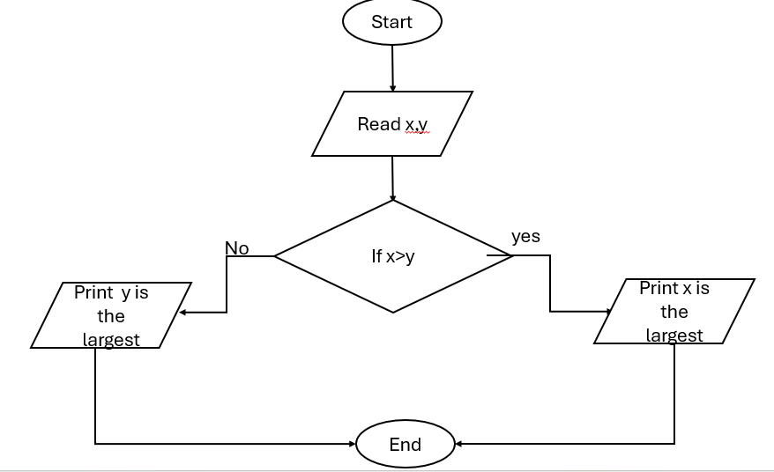
Exercise _ 8
Create a Flowchart to read two numbers then display the largest.

Slide 13
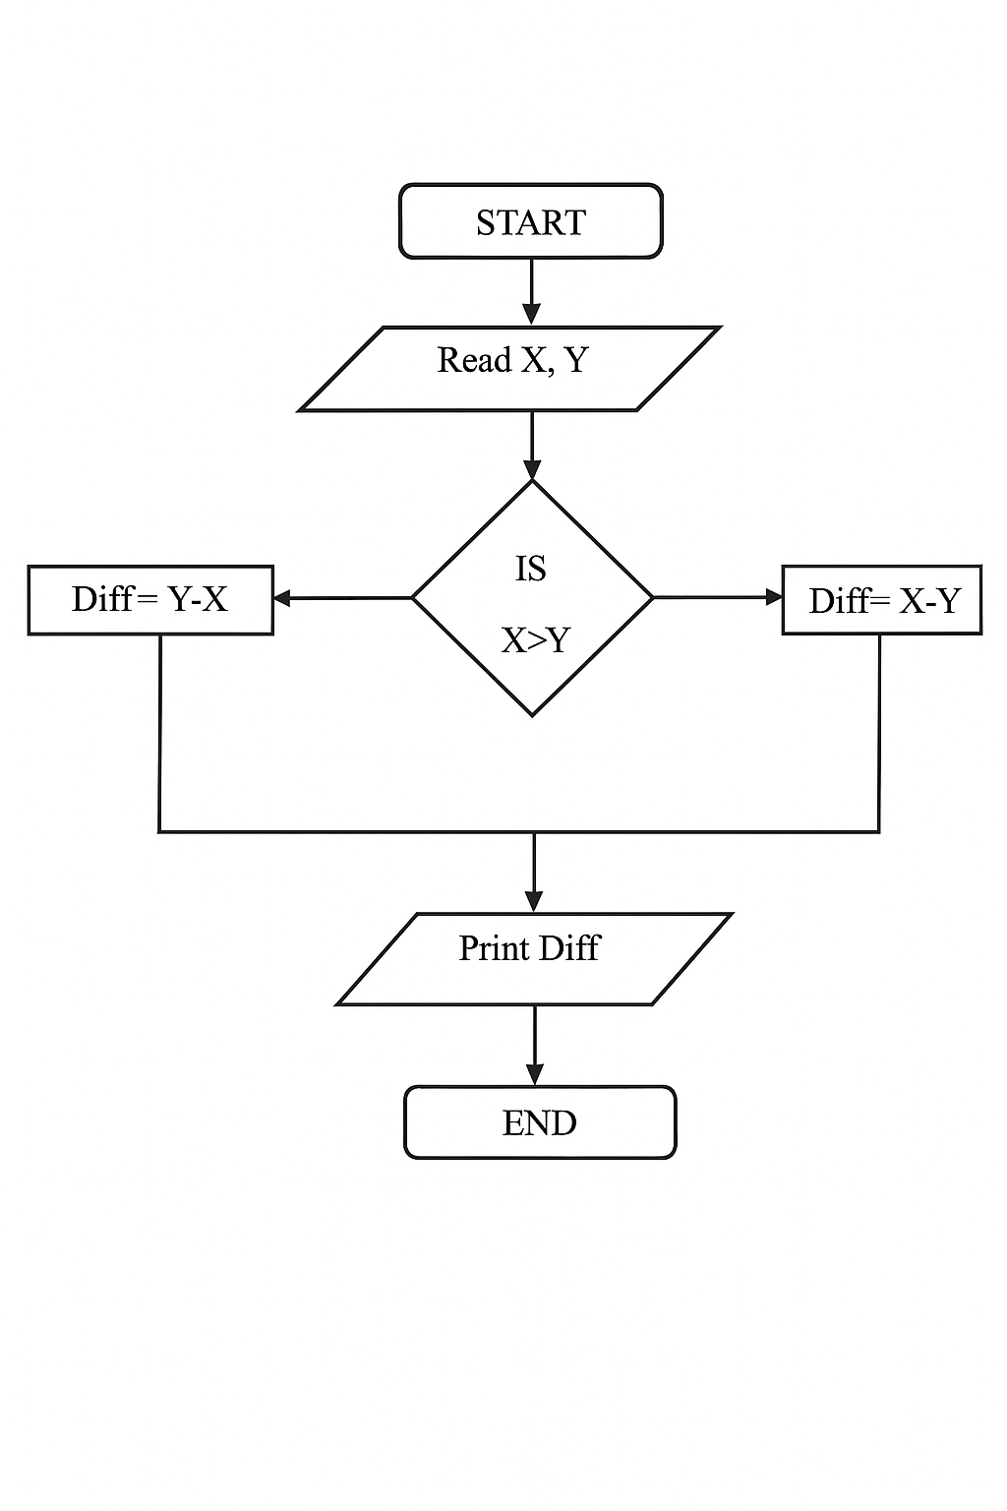
Exercise _ 9
Design a Flowchart that computes the absolute difference of two values (X and Y), where the difference is (X-Y) or (Y-X), which ever is positive.

Slide 14
Repetition Structure
A repetition structure represents part of the program that repeats. This type of structure is commonly known as a loop.
Repetition Structure
Post-Test
Pre-Test

Slide 15
Repetition Structure
In Pre-Test Repetition Structure The condition is tested BEFORE any actions are performed.
In Post-Test Repetition Structure The condition is tested AFTER the actions
are performed
YES
x < y?
Display x
Add1 to x
Display x
Add 1 to x
YES
x < y?

Slide 16
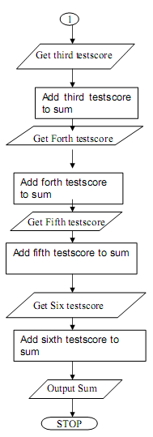
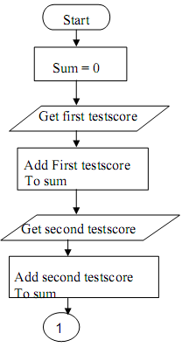
Exercise _ 9
Design a flowchart for adding the test scores as given below: 26, 49, 98, 87, 62, 75

Slide 17
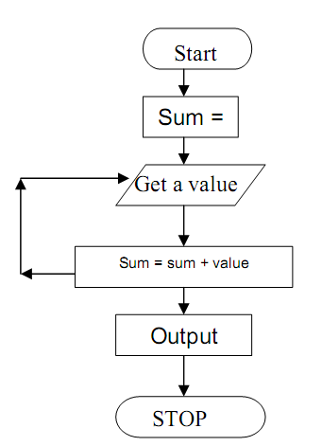
Exercise _ 10
The problem with Exercise_6 have some steps appear more than once, i.e. step 5 get second number, step 7, get third number, etc. One could shorten the algorithm or flowchart as follows:

Slide 18
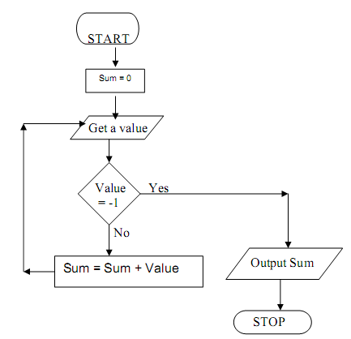
Exercise _ 11
In Exercise_6, step 3 to 5 will be repeated, where a number is obtained and added to the sum . So, we can use repetition structure to represent the answer by adding terminal value to end loop

Slide 19
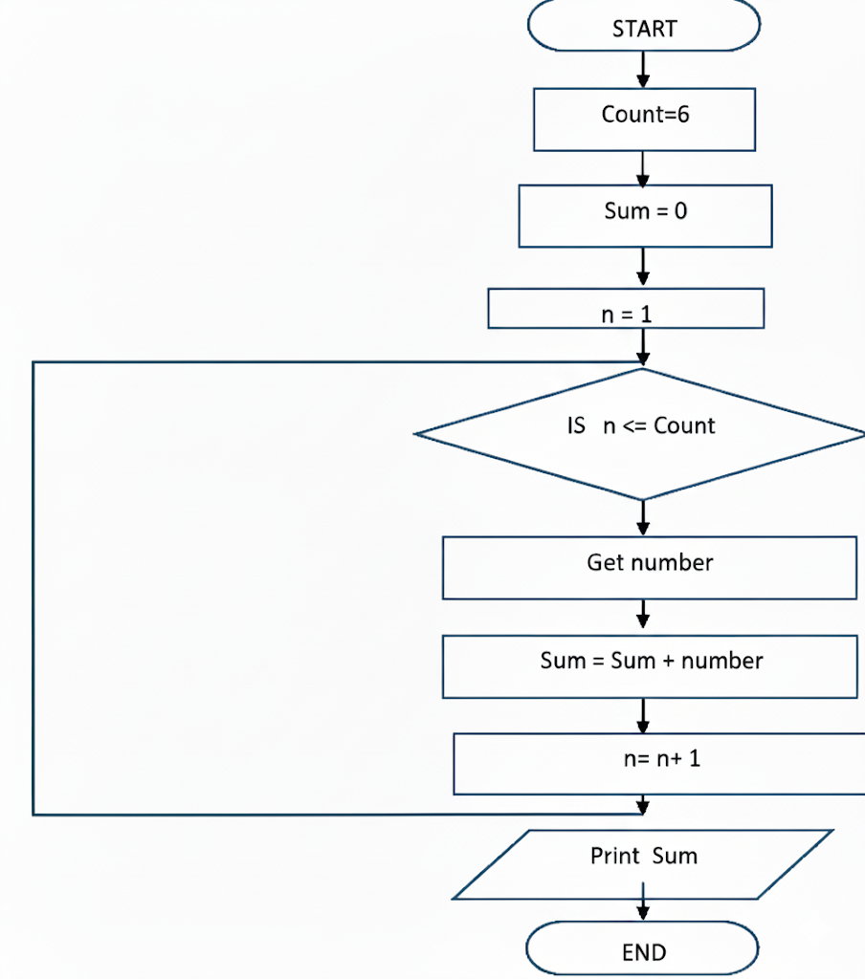
Exercise _ 12
In Exercise_6, steps 3 to 5 will be repeated.

Slide 20
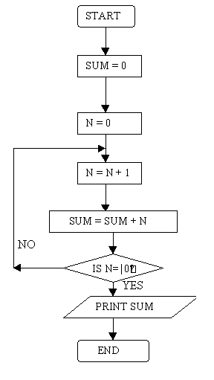
Exercise _ 13
Create a flowchart that read 100 numbers and then display the sum.

Slide 21
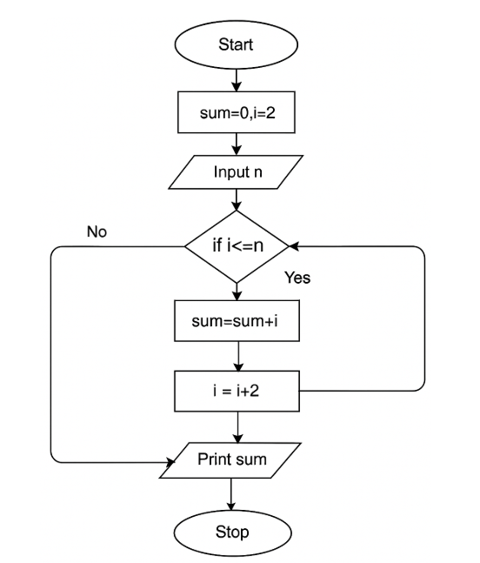
Exercise _ 14
Design an algorithm and the corresponding flowchart for finding the sum of the numbers 2, 4, 6, 8, …, n

Slide 22
Case Structure
One of several possible actions is taken, depending on the contents of a variable.

Slide 23
Case Structure
Example:
If years employed = 2, bonus is set to 200
If years employed = 3, bonus is set to 400
If years employed = 1, bonus is set to 100
If years employed is any other value, bonus is set to 800
CASE
years employed
1
2
3
Other
bonus = 100
bonus = 200
bonus = 400
bonus = 800

Slide 24
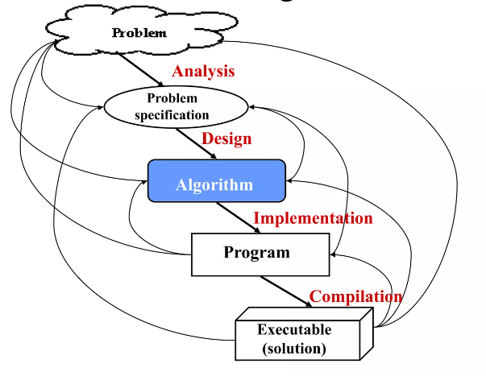
Program
A program is a set of instructions given to the computer to execute successive operations that lead to solving specific problems.
In general, to solve any problem with the computer we must follow these steps:
  Analyze the problem.
  Write an Algorithm.
  Draw flowchart.
  Convert the flowchart to the program.
  Run the program and test the solution.

Slide 25
Programming as a problem-solving process
Define and analyze the problem.
  What is the input & output?
  What other information is necessary?
Develop an algorithm.
  What steps must be done?
Implement a program.
  Compile, test, and debug the program.
Document and maintain the program.
Notes:
Document and maintain the program.توثيق وصيانه البرنامج

Slide 26
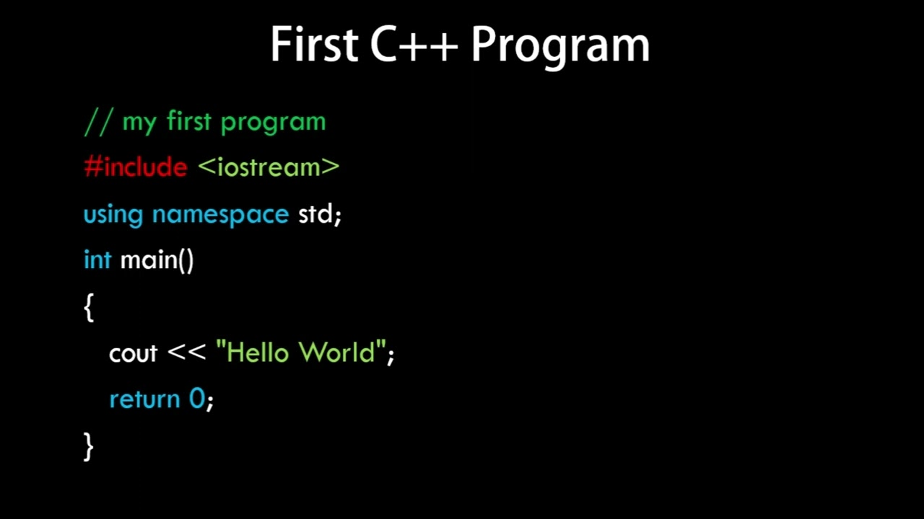
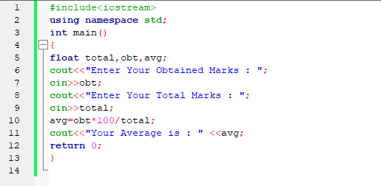
C++ Programming Languages
A program can be written in a programming language, such as C++, which is much easier to understand than machine language.

Slide 27
What can you do with C++?
Gaming
Develop computer software
Desktop apps
Web browsers
OS( operating system )

Slide 28
C++ Programming Languages
When a C++ program is written, it must be typed into the computer and saved to a file.
A text editor, which is similar to a word processing program, is used for this task.
The statements written by the programmer are called source code, and the file they are saved in is called the source file.
After the source code is saved to a file, the process of translating it to machine language can begin.
During the first phase of this process, a program called the preprocessor reads the source code.

Slide 29
C++ Programming Languages
The preprocessor searches for special lines that begin with the
# symbol.
These lines contain commands that cause the preprocessor to modify the source code in some way.
During the next phase the compiler steps through the preprocessed source code, translating each source code instruction into the appropriate machine language instruction.
This process will uncover any syntax errors that may be in the program. Syntax errors are illegal uses of key words, operators, punctuation, and other language elements. If the program is free of syntax errors, the compiler stores the translated machine language instructions, which are called object code, in an object file.
Notes:
integrated development environments (IDEs)

Slide 30
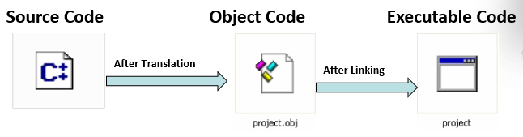
Source Code, Object Code, and Executable Code
Source code refers to the lines of code that a programmer types into the computer.
A file containing source code is called a source file.
Object code is the output of a compiler after it translates source code
A file containing object code is called an object file.
Executable code" refers to the code that can run directly on your computer. This is usually obtained by linking your object code.

Slide 31
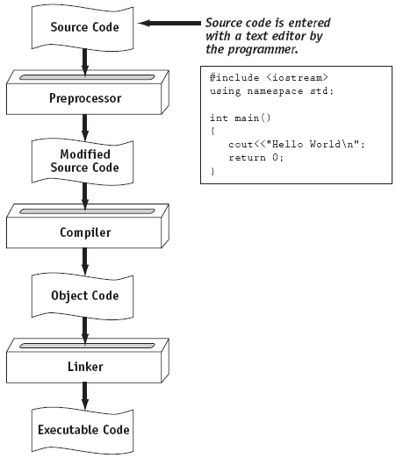
From a High-Level Program to an Executable File

Slide 32
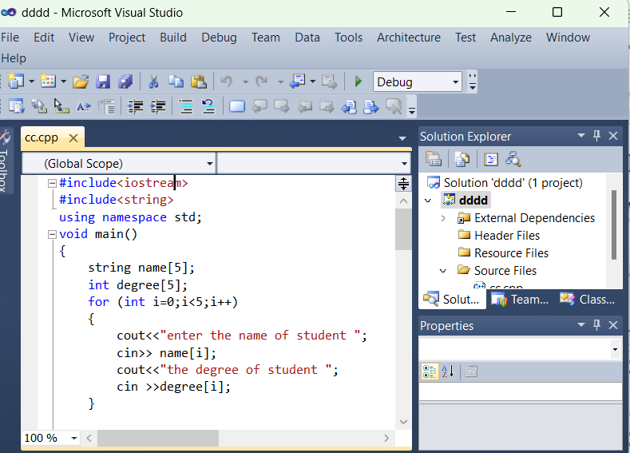


Integrated Development Environments (IDEs)
An integrated development environment, or IDE, combines all the tools needed to write, compile, and debug a program into a single software application.
Examples are Microsoft Visual C++

Slide 33

What is a Program Made of?

Slide 34
What is a Program Made of?
Common elements in programming languages:
  Key Words
  Programmer-Defined Identifiers
  Operators
  Punctuation
  Syntax

Slide 35
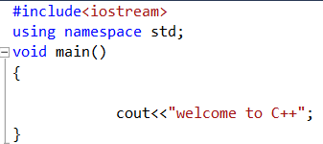
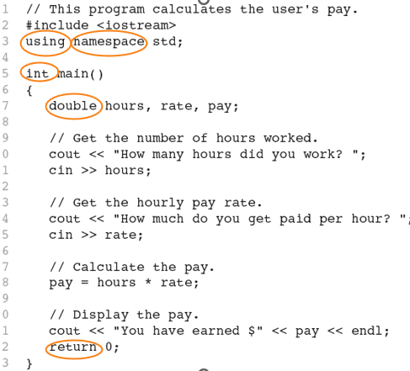
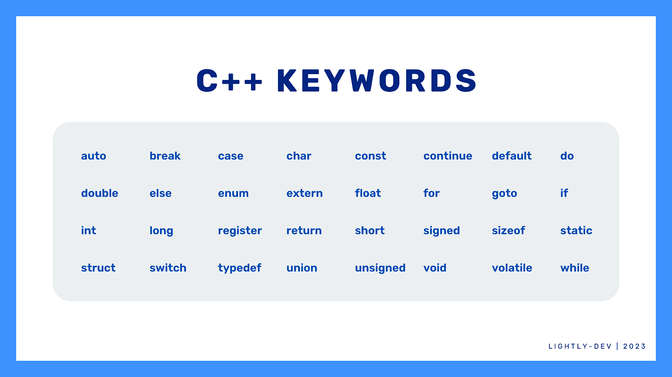
Key Words
Also known as reserved words
Have a special meaning in C++
Can not be used for any other purpose
Written in lowercase letter
Keywords in the Program 1-1

Slide 36
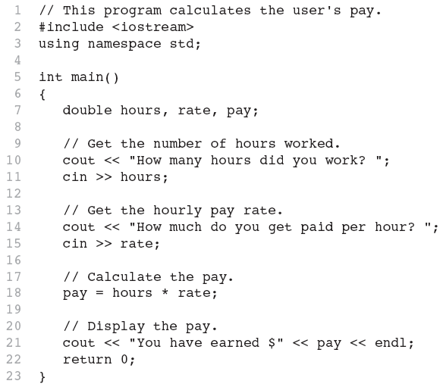
Programmer-Defined Identifiers
Names made up by the programmer
Not part of the C++ language
Used to represent various things: variables (memory locations), functions, etc.
In Program 1-1: hours, rate, and pay.

Slide 37
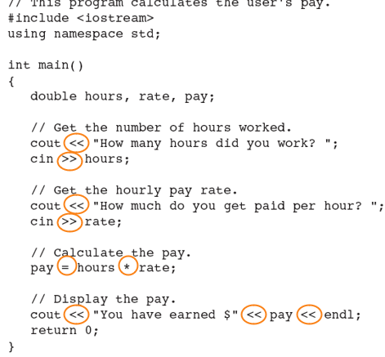
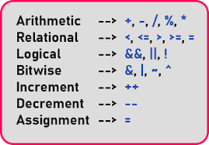
Operators
Used to perform operations on data
Many types of operators:
  Arithmetic - ex: +,-,*,/
  Assignment – ex: =
Some operators in Program1-1:
<< >> = *

Slide 38
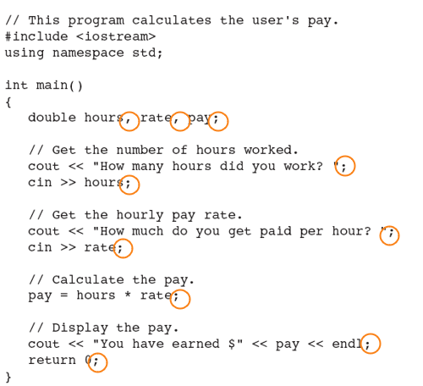
Punctuation
Characters that mark the end of a statement, or that separate items in a list
In Program 1-1: , and ;

Slide 39
Syntax
The rules of grammar that must be followed when writing a program
Controls the use of
  key words,
  operators,
  programmer-defined symbols,
  and punctuation

Slide 40
Lines vs. Statements
In a source file,
  A line is all of the characters entered before a carriage return.
  Blank lines improve the readability of a program.
  Here are four sample lines. Line 3 is blank:
    1. double num1 = 5, num2, sum;
    2. num2 = 12;
    3.
    4. sum = num1 + num2;

Slide 41
Lines vs. Statements
In a source file,
  A statement is an instruction to the computer to perform an action.
  A statement may contain keywords, operators, programmer-defined identifiers, and punctuation.
  A statement may fit on one line, or it may occupy multiple lines.
  Here is a single statement that uses two lines:
  double num1 = 5,
  num2, sum;

Slide 42
Variables
A variable is a named storage location in the computer’s memory for holding a piece of data.
To create a variable in a program you must write a variable definition (also called a variable declaration)
There are many different types of data, which you will learn about in this course.
A variable holds a specific type of data.
The variable definition specifies the type of data a variable can hold and the variable name.
Example
  int num1;
  Double grade ;
  String name;

Slide 43
Input, Processing, and Output

Slide 44
Input, Processing, and Output
Three steps that a program typically performs:
  Gather input data:
    from keyboard
    from files on disk drives
  Process the input data
  Display the results as output:
    send it to the screen
    write to a file

Slide 45
The Programming Process
The programming process consists of several steps, which include design, creation, testing, and debugging activities.
  define what the program is to do.
  Visualize the program running on the computer.
  Use design tools to create a model of the program(Hierarchy charts, flowcharts, pseudocode, etc.)
  Check the model for logical errors.
  Write the program source code.
  Compile the source code.
  Correct any errors found during compilation.
  Link the program to create an executable file.(The linker takes all the object files and combines them into a single executable file (like program.exe on Windows or a.out on Linux).)
  Run the program using test data for input.
  Correct any errors found while running the program.
  Validate the results of the program.

Slide 46
Thank you

